Slide 1
Biometric security

Slide 2
Presentation attacks
Presentation attacks involve an impostor using an artefact of some kind to mimic an individual who has been enrolled in the system.
For example: If a fingerprint of the enrolled individual can be captured, this could be used to make a matching artefact. For face recognition, a portrait photo of the target might easily be taken covertly and used to create an artefact.

Slide 3
Sensor output interception
An attacker may seek to modify or intercept the data output from the sensor. A previously captured sample might be replayed, or a captured biometric sample could be substituted with biometric data of a different individual at enrolment.
Intercepted data might be used by an attacker to obtain the biometric characteristics of an enrolled individual for use in future attacks.

Slide 4
Reference and database-related vulnerabilities
An attacker may target data during transmission, or in storage by the biometric system. For example, a biometric reference in the enrolment database could be modified to include the biometric features of an impostor.
In implementations where the biometric data is stored on a device held by the individual, such as a mobile phone, passport or ID card, an attacker with possession of the device would have unfettered access to the biometric data unless it is protected by built-in security features.

Slide 5
Integrity of enrolment
There is a possibility that the enrolment process could be subverted, allowing the acceptance of inappropriate enrolment data. For example if an artefact is enrolled in the system, then an attacker might later be able to use the same artefact to be recognised.
Alternatively, if an enrolment record contains biometric data of two individuals (for example the right hand is properly enrolled, but the enrolled left hand is that of another individual, or if a face enrolment uses an image which morphs together photographs of two individuals) this may allow one individual to impersonate the other.

Slide 6
System attacks
Attacks against the underlying IT on which the biometric system runs are certainly feasible and must be considered in cases where the assets being protected are of significant value and where the attackers are relatively sophisticated.
Generally, the mitigation of such attacks relies on traditional IT security methods which are not specific to biometric systems.

Slide 7
Denial of service attacks
All systems are vulnerable to denial of service attacks. In the case of a biometric system, this will divert subjects to the exception handling system. It is therefore important that this fallback system is no less secure than the biometric system.

Slide 8
Insider threat
All security systems are vulnerable to an attack by a trusted system administrator or operator. Due to the level of access and trust held by such people, insider attacks on a biometric system can take any of the forms outlined above.

Slide 9
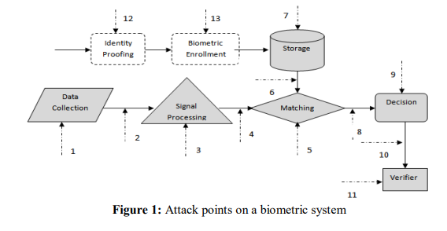

Slide 10
Known attacks in biometric systems
Replay Attack: In this attack, the data stream which is contained in the biometric system is injected between the sensor and the processing system. A replay attack can be of two to three stage process. It first intercepts or copies the sensor transmission, then it modifies or alters the information, thus finally replaying the data.
Spoofing the Feature set: The replacing of the feature set with fake or altered features are called spoofing of data. These types of spoofing attacks are typically used to attack various networks, spread malware and to gain confidential information.
Template Tampering Attack: A template represents a set of salient features that summarizes the biometric data (signal) of an individual. The templates can be modified to obtain a high verification score, no matter which image is presented to the system. The templates which are stored in the database can be replaced, stolen or even can be altered.

Slide 11
Overriding Yes/No response: An inherent error prevailing in your biometric systems is that the result of the system is always a binary response, Yes/No (i.e., either match/no match). In other words, there is still a fundamental disconnecting between the biometric and applications, which make the system, open to potential attacks.
Trojan horse attack: In Trojan horse attack the feature extractor is itself replaced to produce the desired features and to add on those features in the existing database. The spoof detection technology has become a crucial part of a biometric system as with an increasing concern for security, the biometric attacks are to be identified, controlled and minimized. Researchers are developing various new approaches for a secure biometric system.
Masquerade attack: It was demonstrated that a digital "artifact" image could be created from a fingerprint template so that this artifact is submitted to the system, will produce a match.

